Slide 1
Vision Transformers for Physics Prediction
Anthony Kalaydjian
4 July 2025

Slide 2
Agenda
01
03
Problem statement
Experiments
02
04
Method
Results

Slide 3
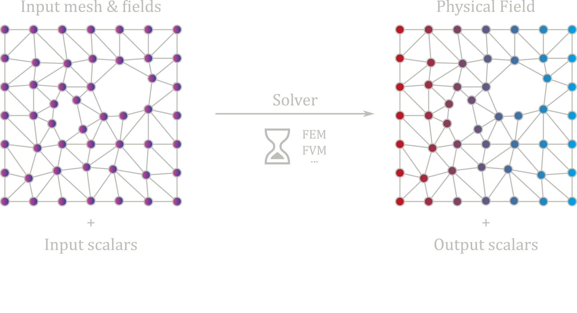
Problem statement

Slide 4
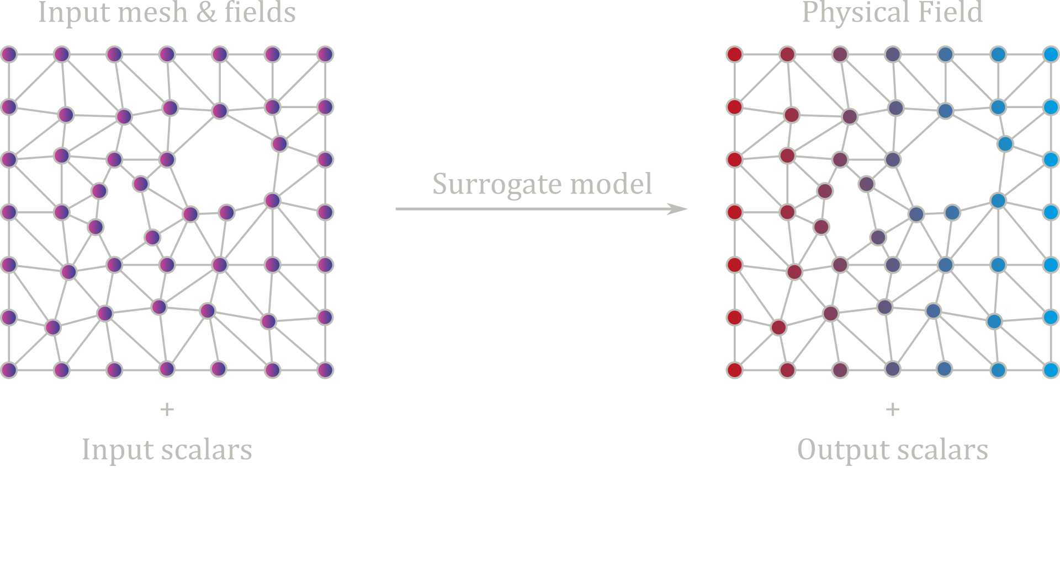
Problem statement

Slide 5
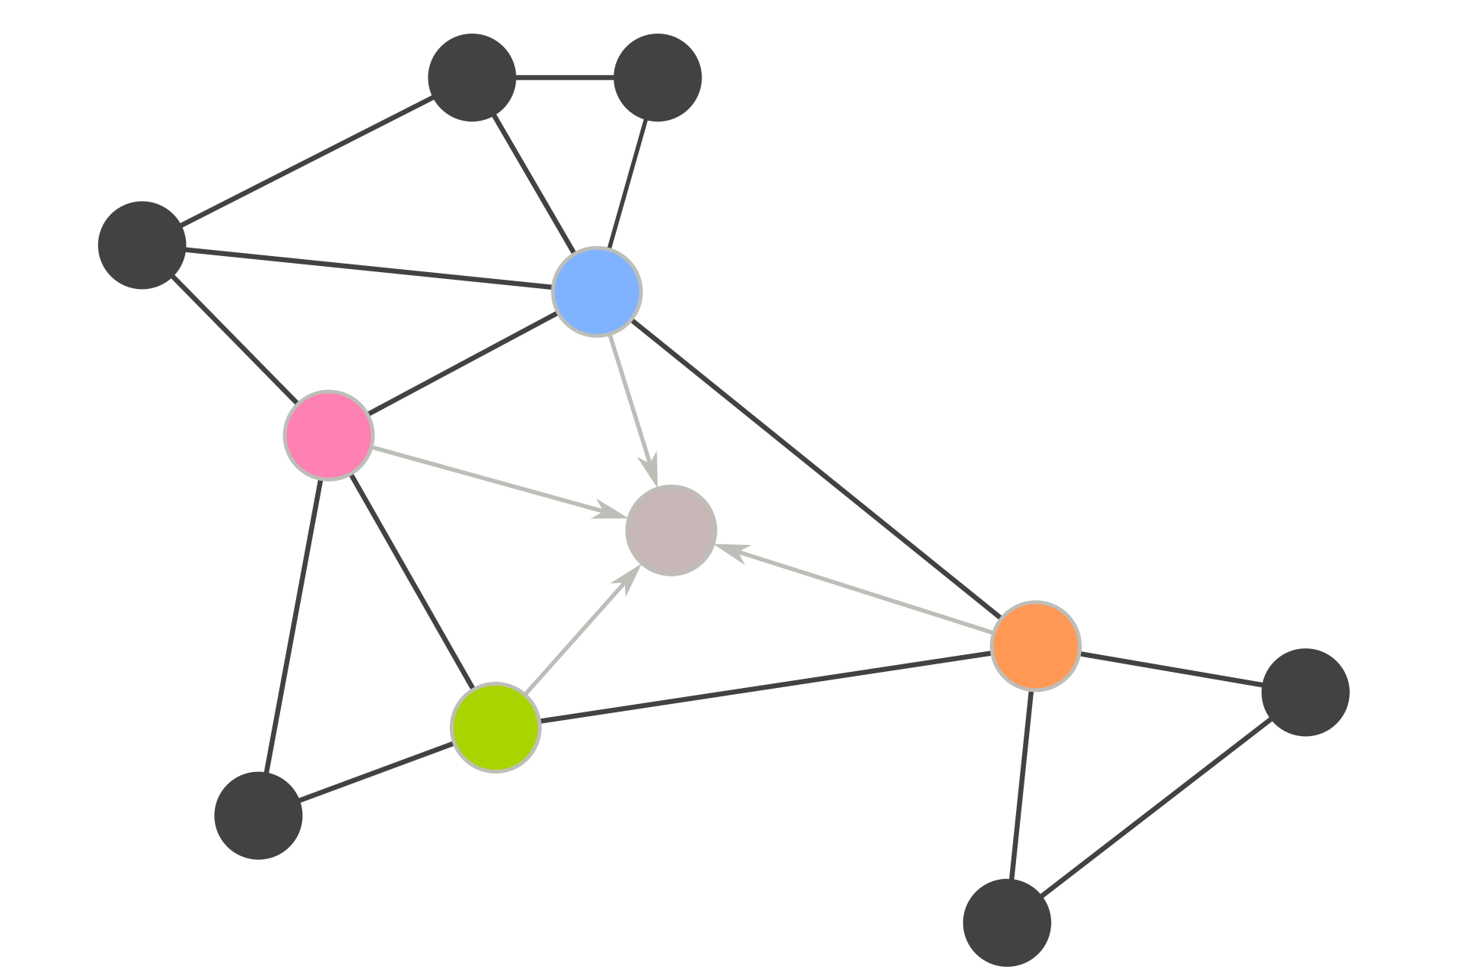
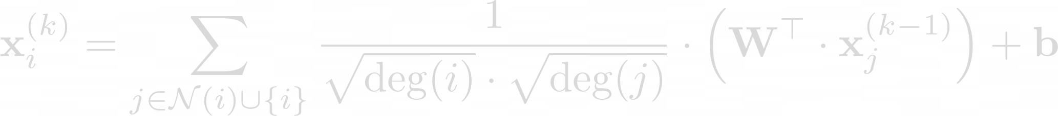
Problem statement

Slide 6
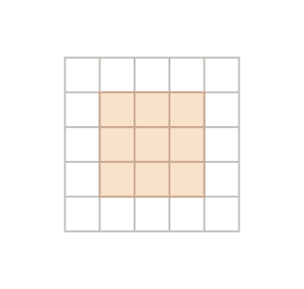
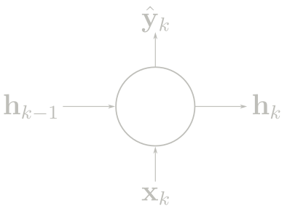
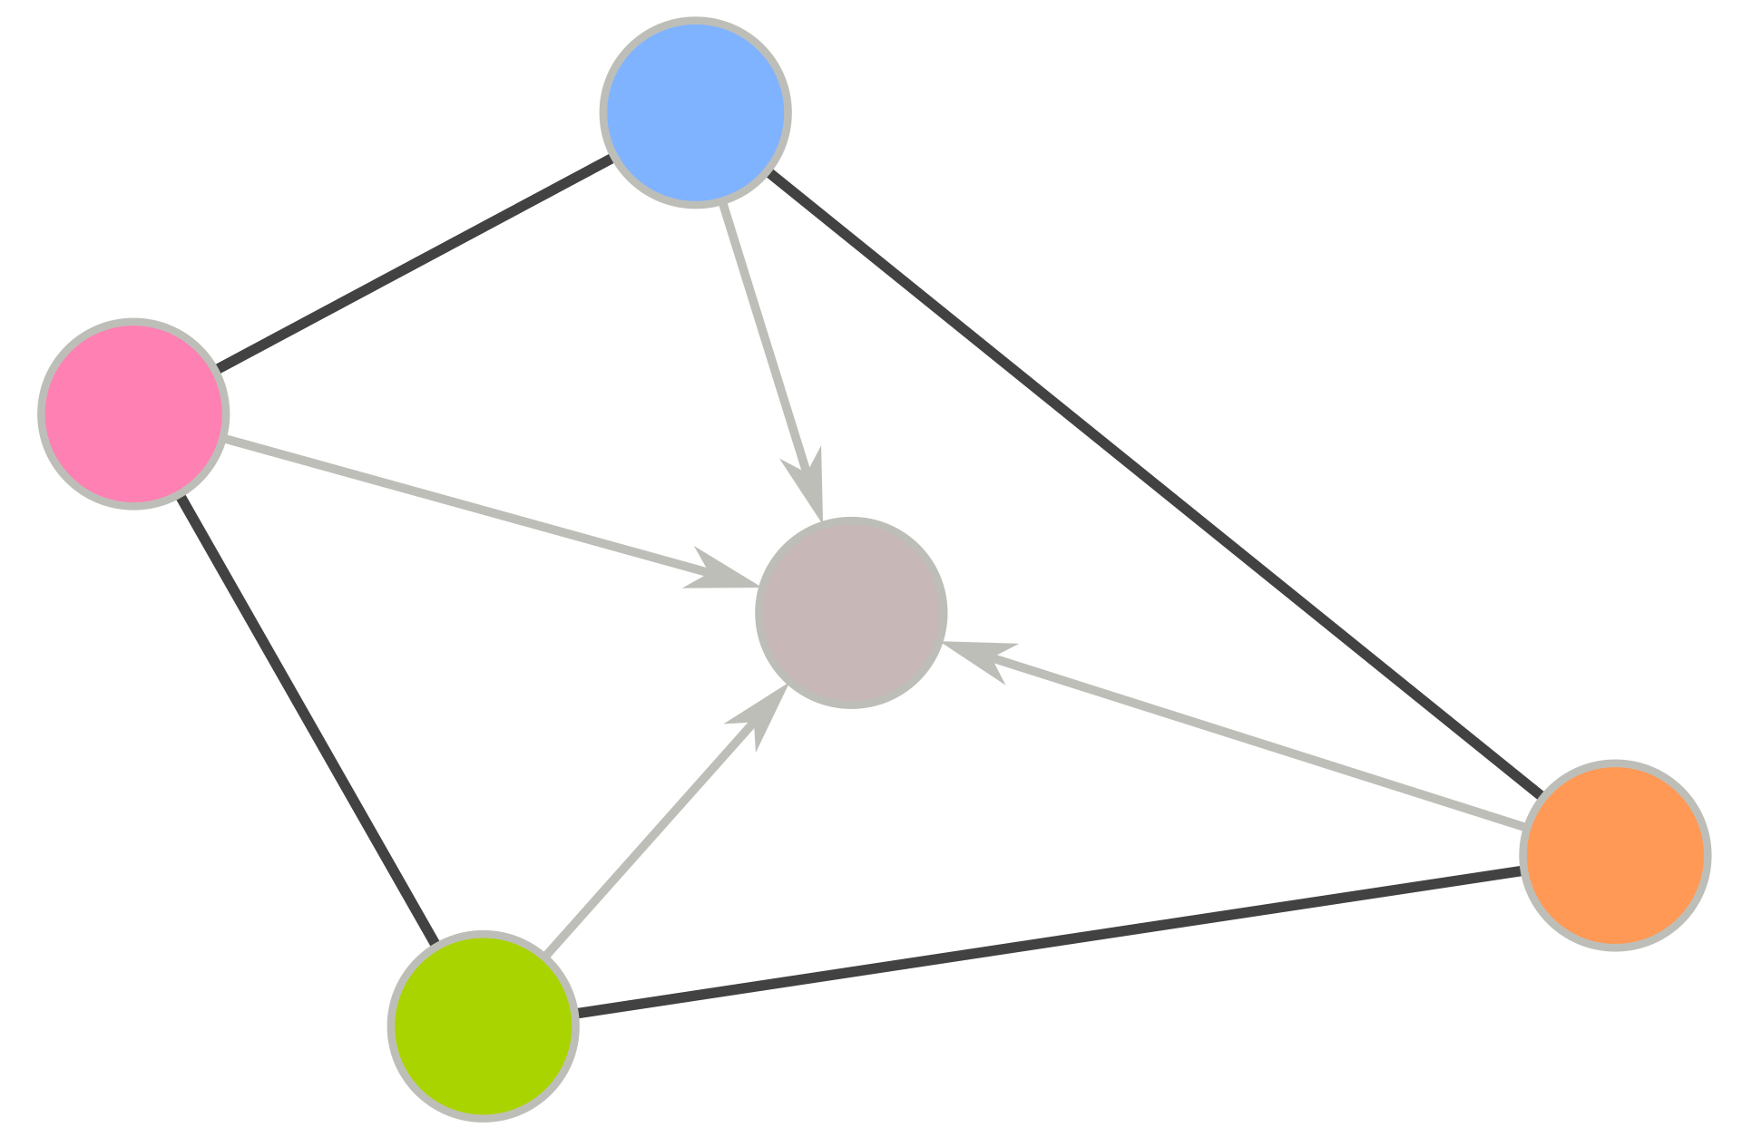
Problem statement
RNN
CNN
GNN

Slide 7
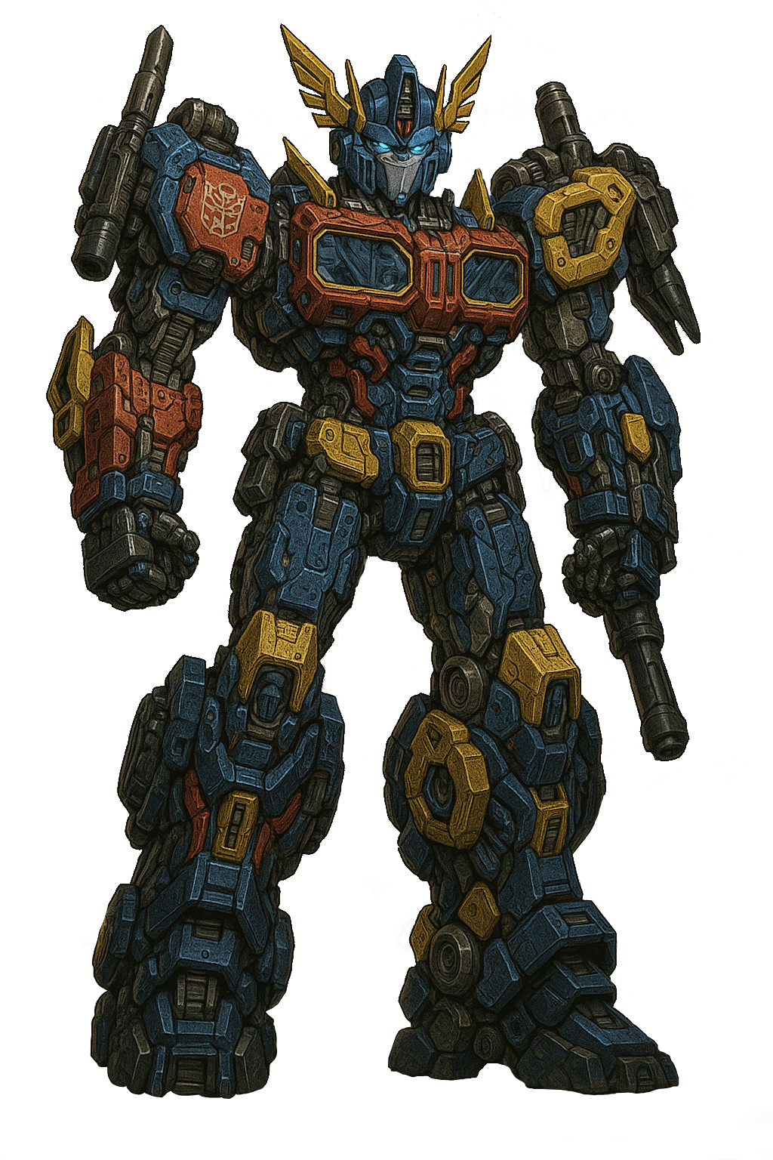
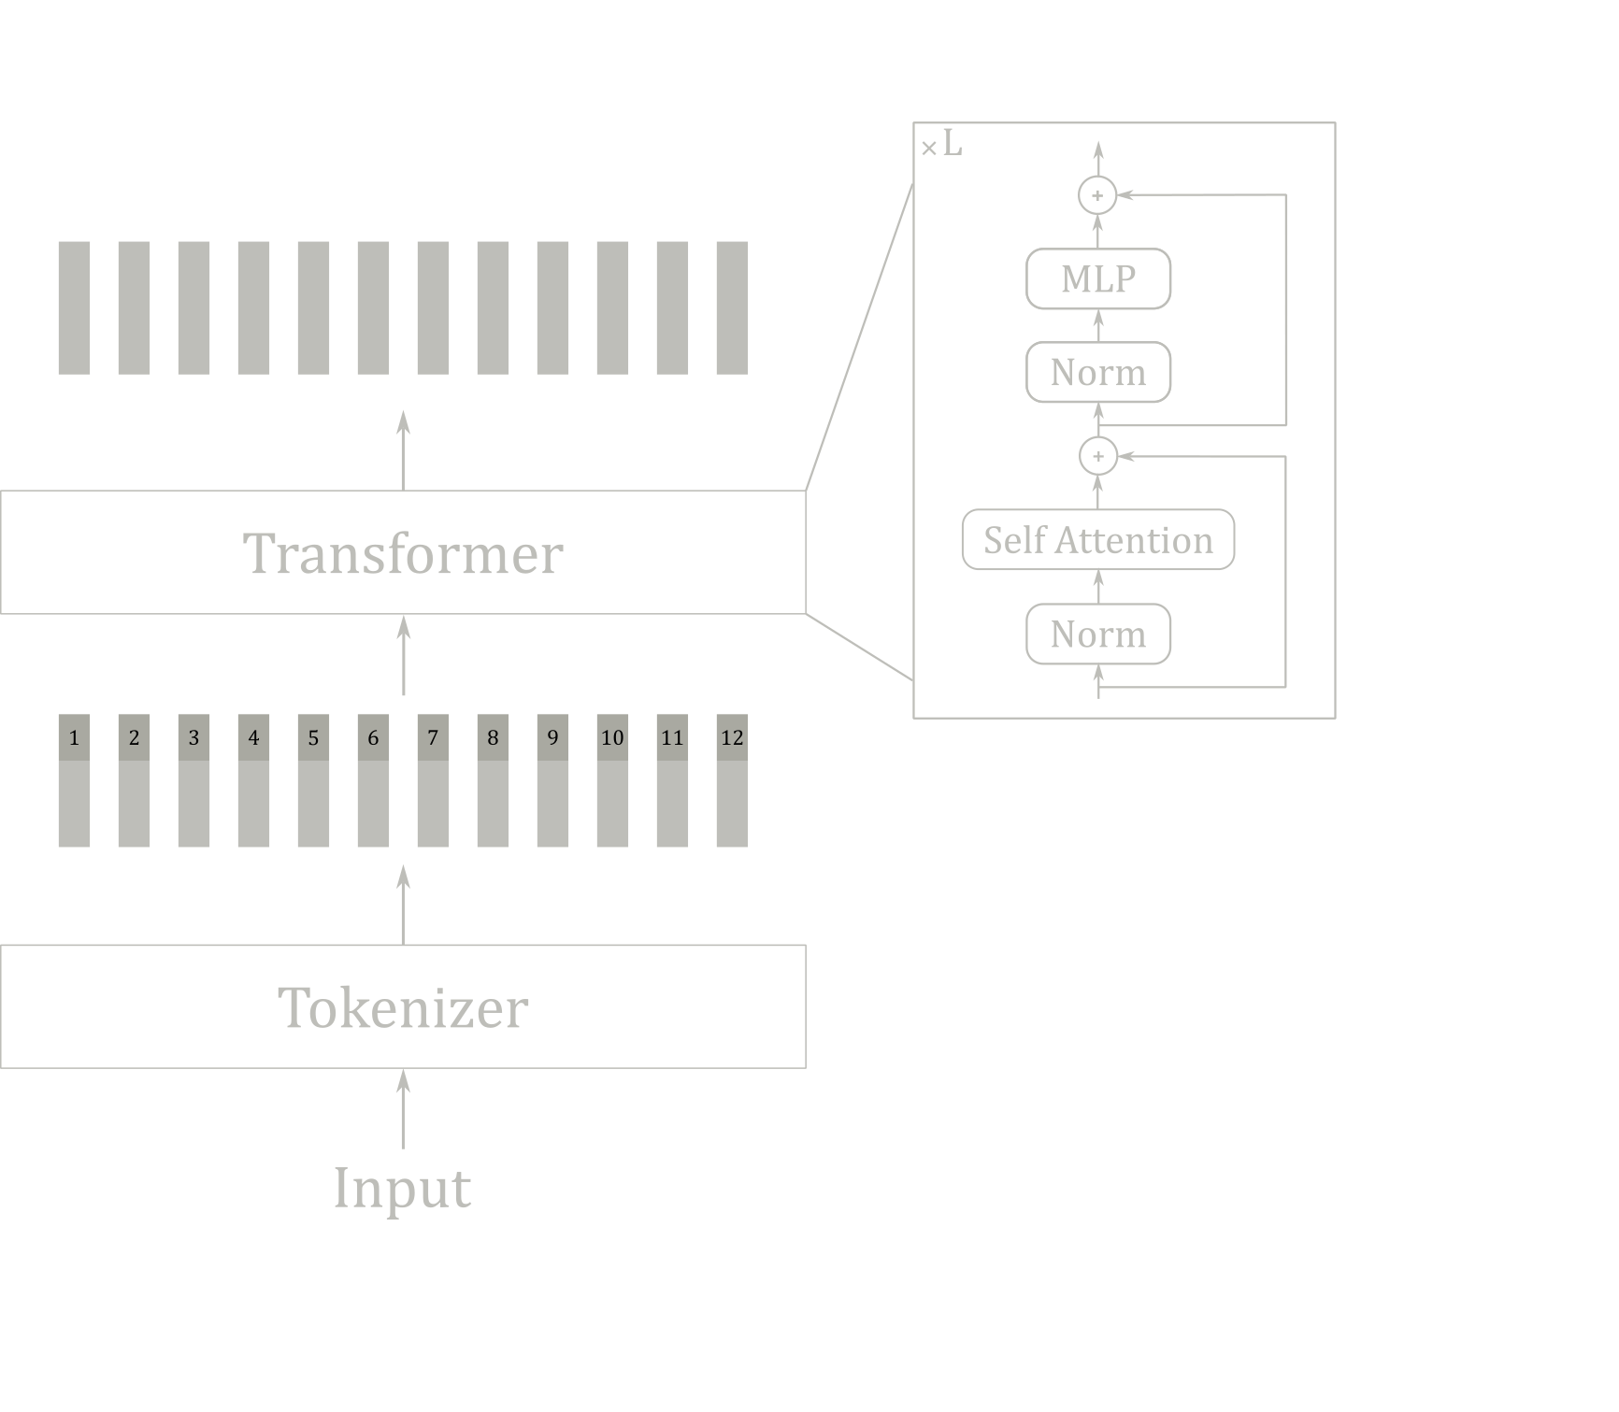
Method
Transformer generated by a transformer

Slide 8



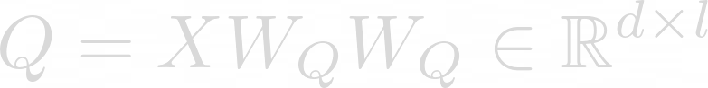



Method
Attention
Self-Attention

Slide 9
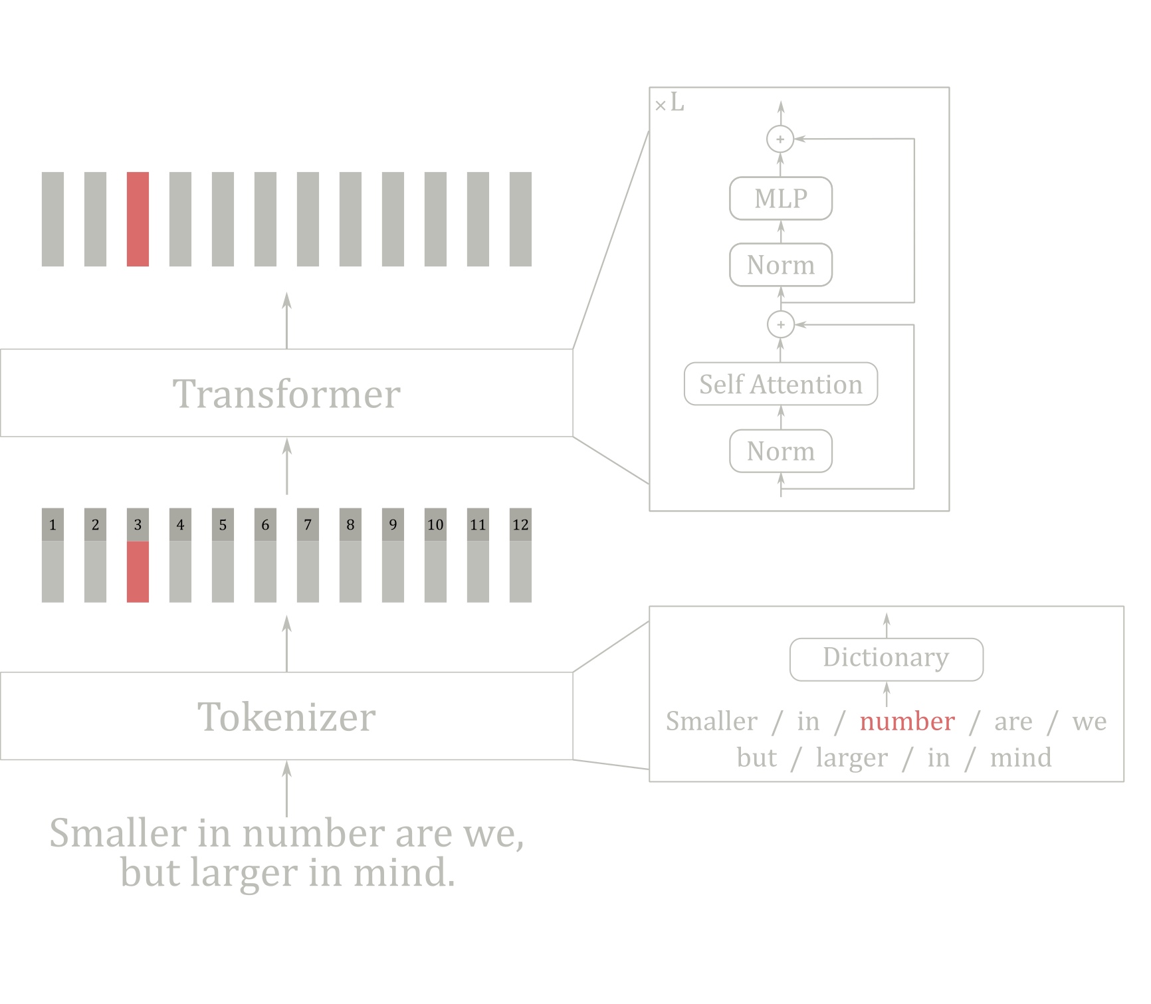
Method
Transformers in NLP

Slide 10
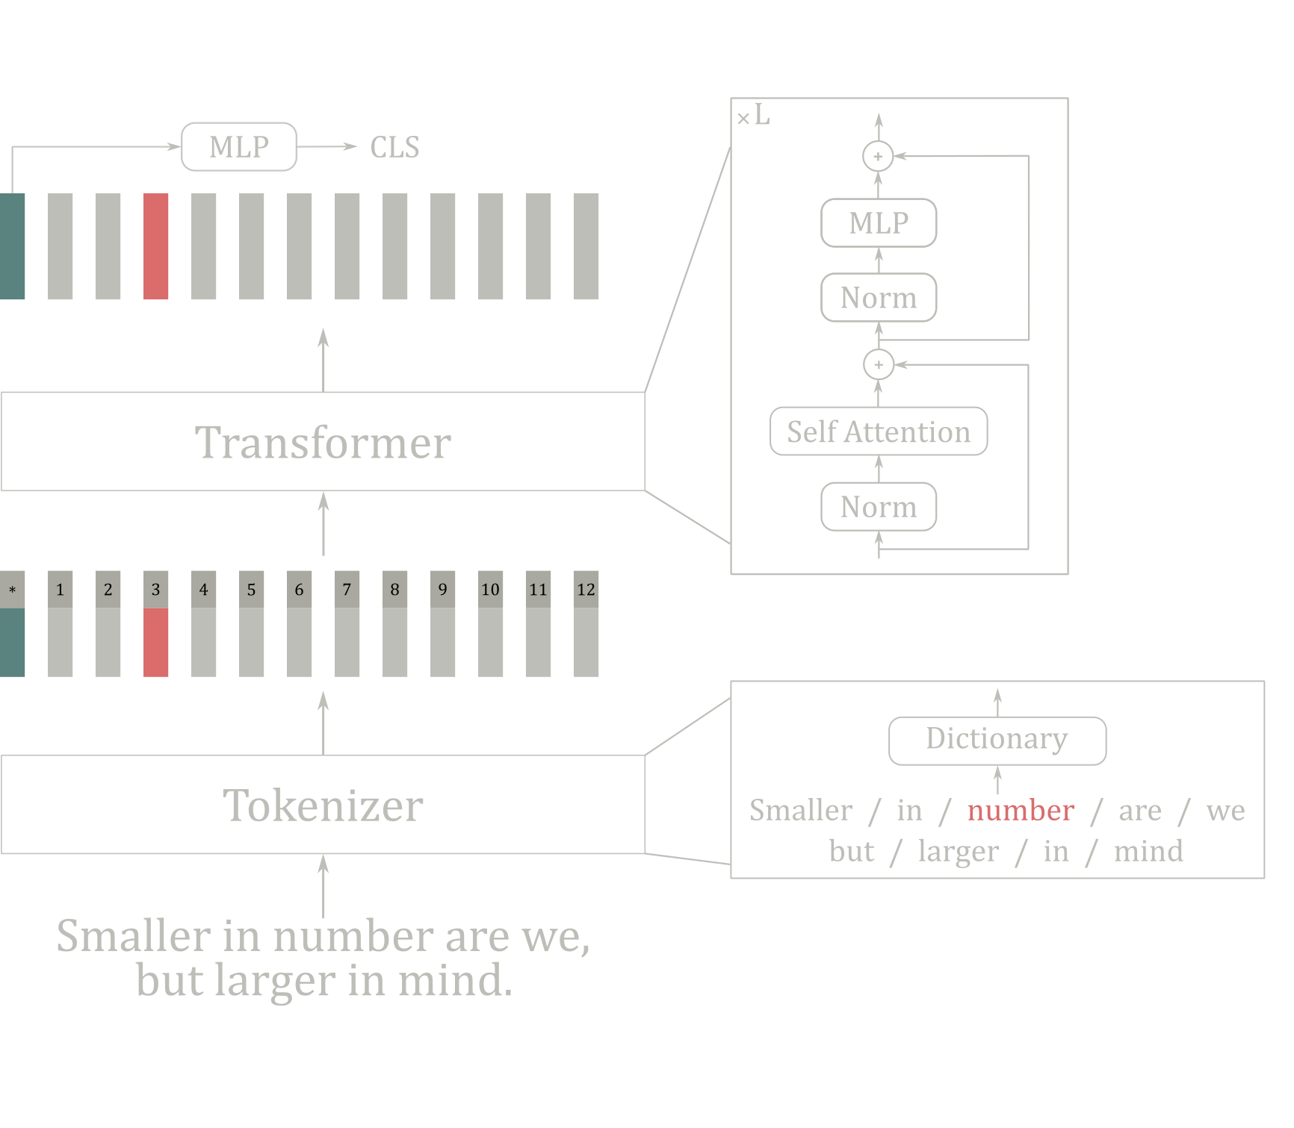
Method
Transformers in NLP

Slide 11
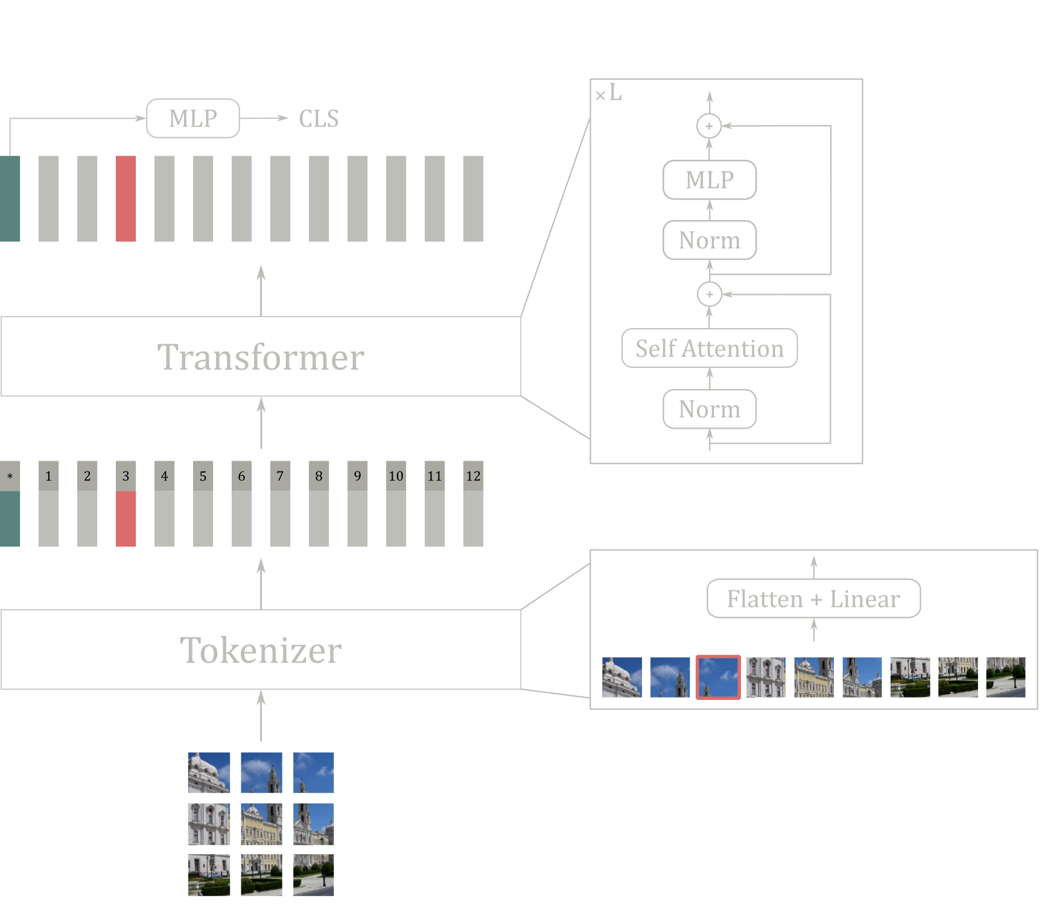
Method
Transformers in CV

Slide 12
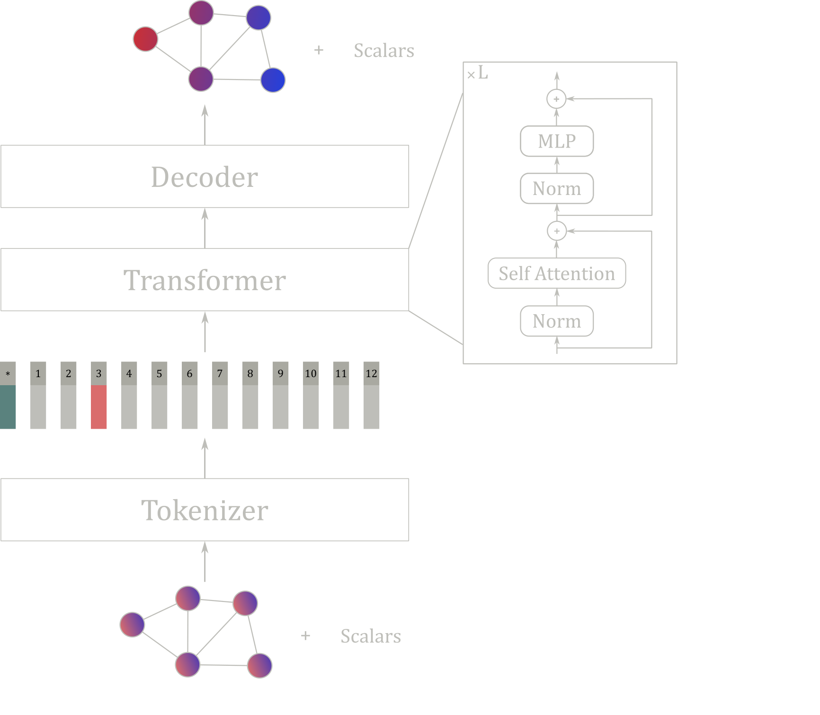
Method
Transformers on meshes?

Slide 13
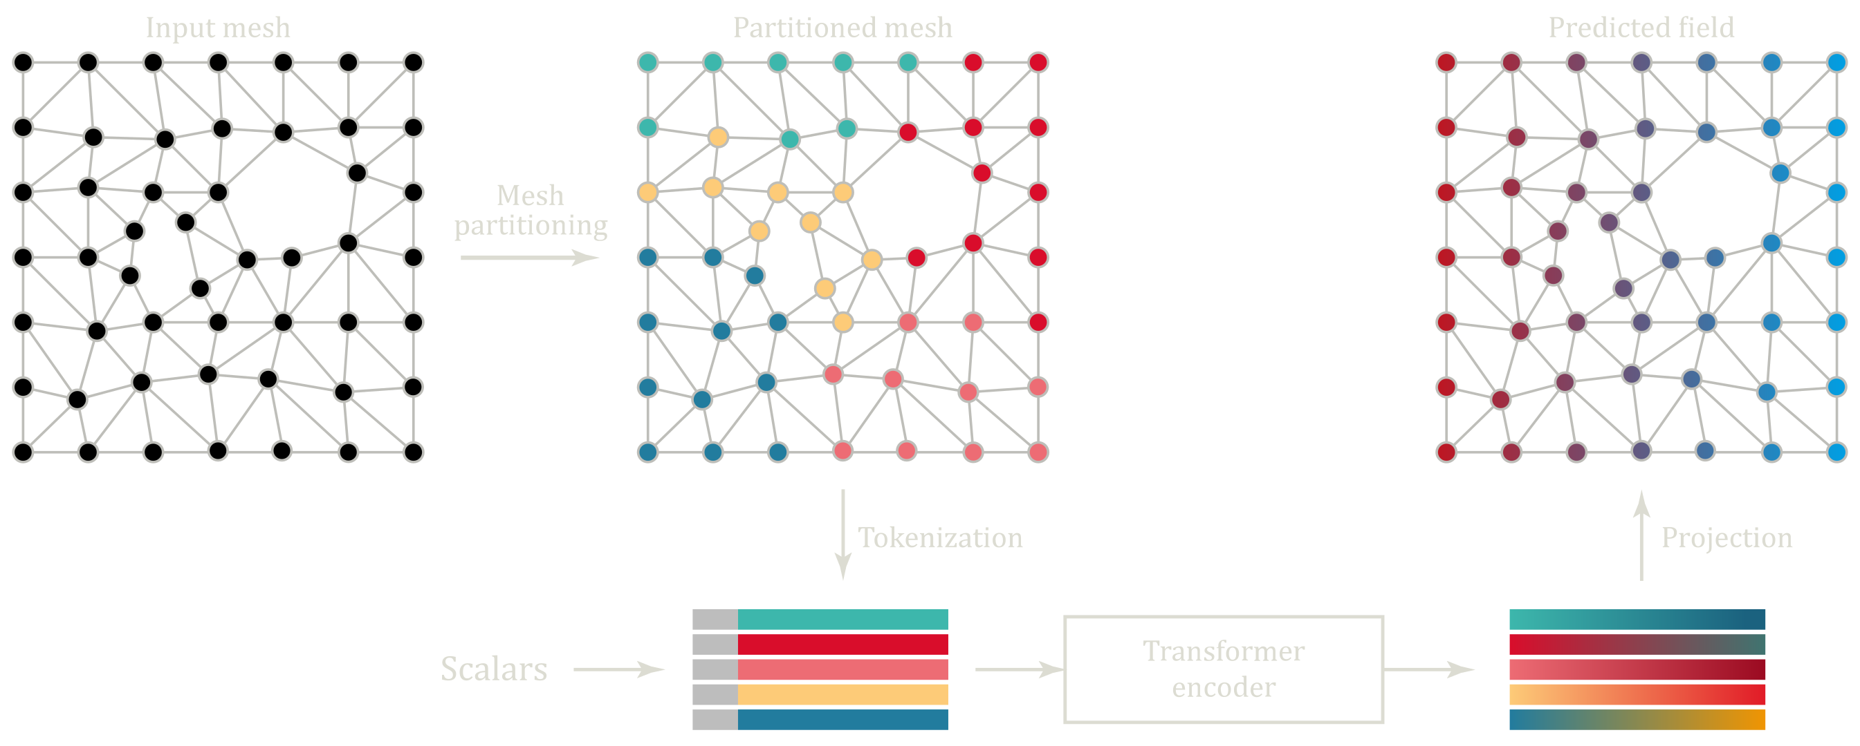
Method
ViT for meshes

Slide 14

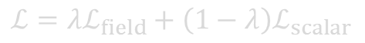
Method
ViT for meshes
Features:
Position (x, y, z)
SDF
Vector to the closest border
Train loss:
$$ℒ=λℒ_{field}+\left(1−λ\right)ℒ_{scalar}$$
$$λ∈\left[0, 1\right]$$

Slide 15
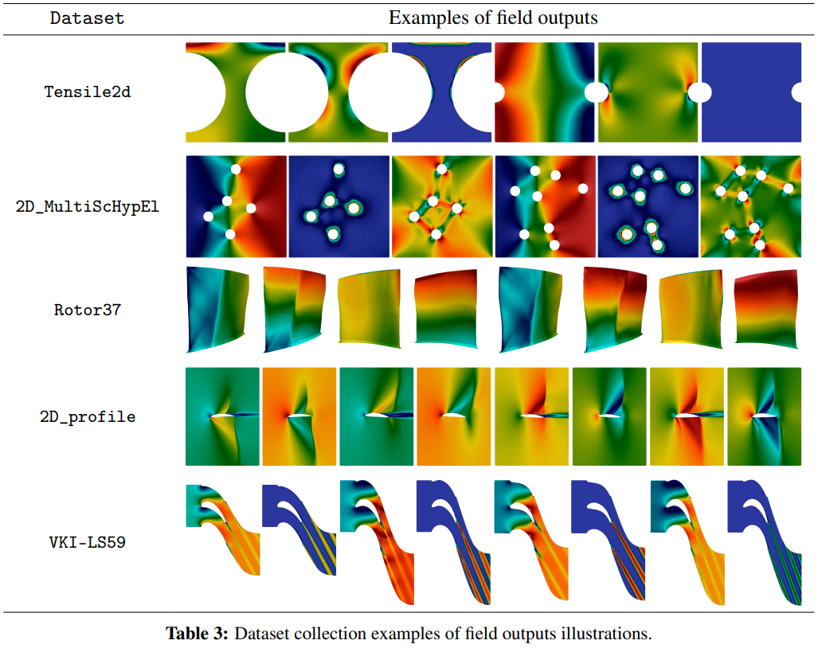



Experiments
Evaluation
PLAID Benchmark

Slide 16
Experiments
Questions
Patch regularity
Order of nodes within each patch?
Cross-sample partitioning consisitency (relative position of patches)?
Shape of patches?
Positional encoding?

Slide 17
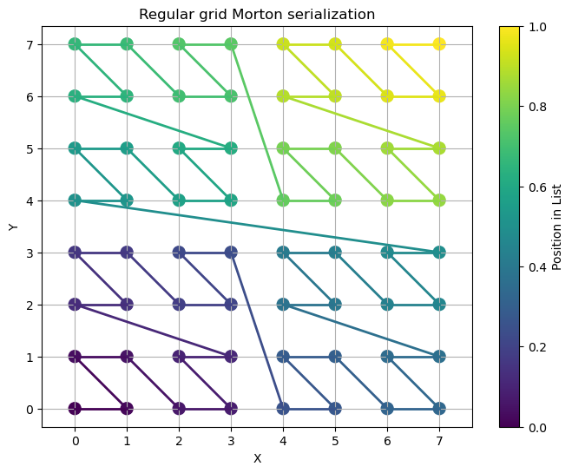
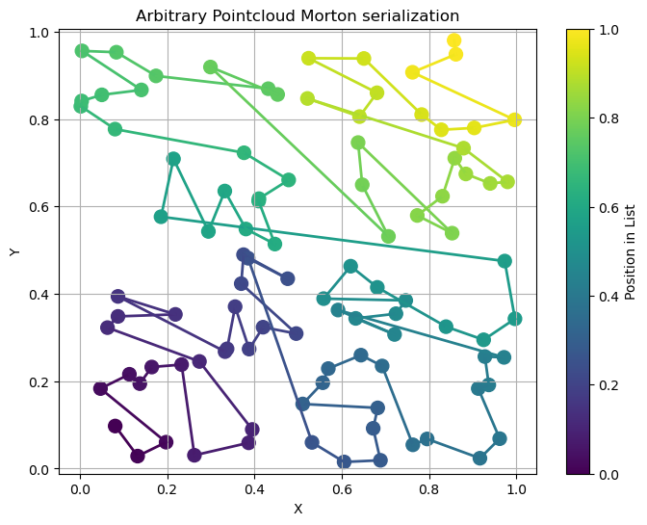
Experiments
Order of points within each patch
Morton ordering

Slide 18
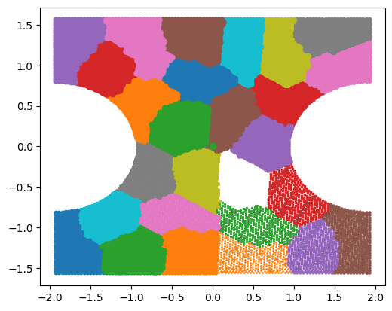
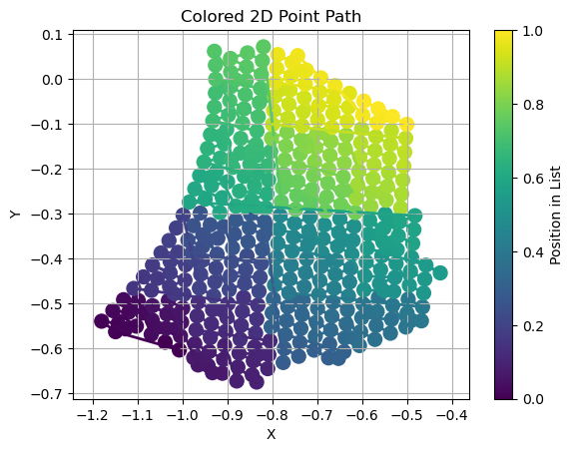
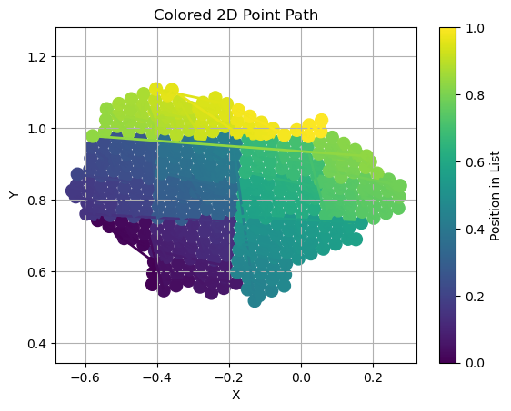
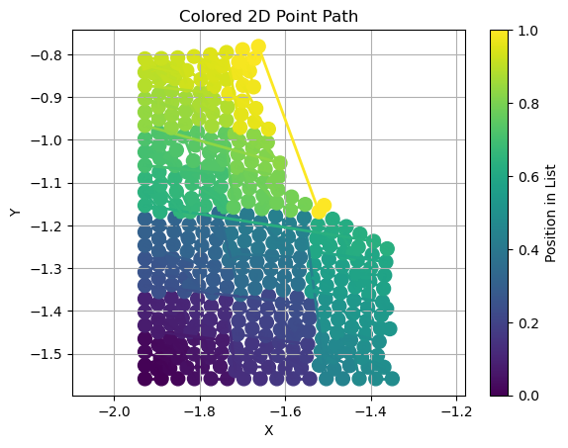
Experiments
Order of points within each patch
Morton ordering

Slide 19
Experiments
Parameter | Ordering
 | Random | Morton
U1 | 0.025 | 0.020
U2 | 0.024 | 0.023
Sig11 | 0.057 | 0.045
sig22 | 0.029 | 0.025
sig12 | 0.044 | 0.037
max_von_mises | 0.019 | 0.019
max_U2_top | 0.034 | 0.025
max_sig22_top | 0.003 | 0.003
total_error | 0.029 | 0.025
Order of points within each patch
Morton ordering 🧐
Parameter | Value
Layers | 8
Latent dim | 512
Dim ff | 256
Activation | GeLU
Patch size | 10
Hyperparameters
Patch ordering results

Slide 20
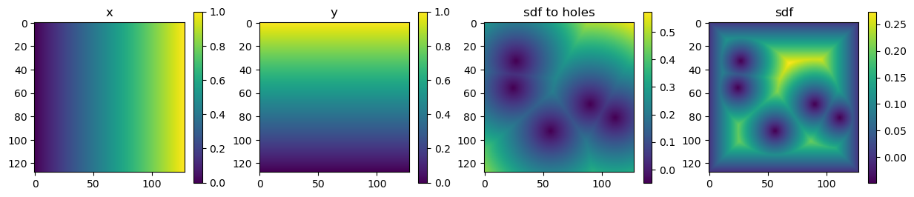

Experiments
Patch regularity? Cross-sample partitioning consistency / Patch shape?
Mesh → image
Powerful mesh processing with Muscat

Slide 21
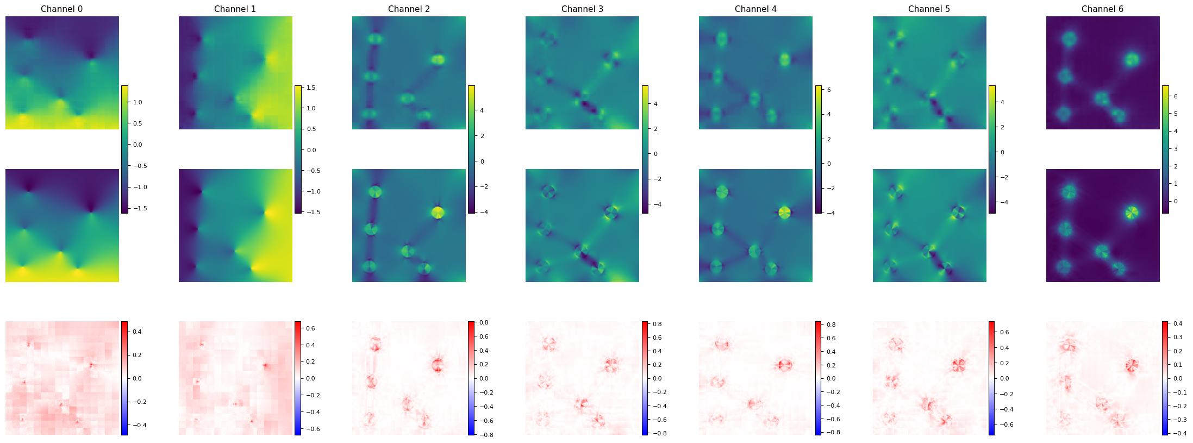
Experiments
Patch regularity? Cross-sample partitioning consistency / Patch shape ✅
ViT with 2D patch PE

Slide 22
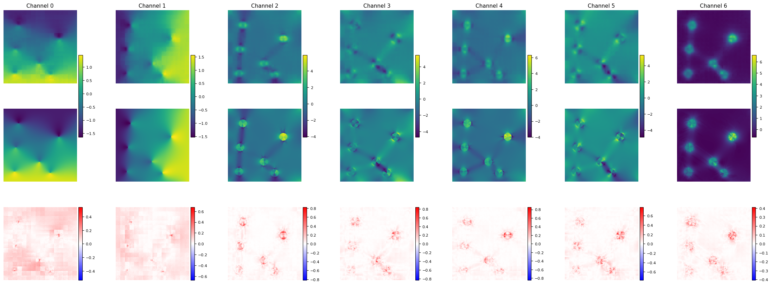
Experiments
Positional encoding? ❌
ViT with 2D patch PE

Slide 23
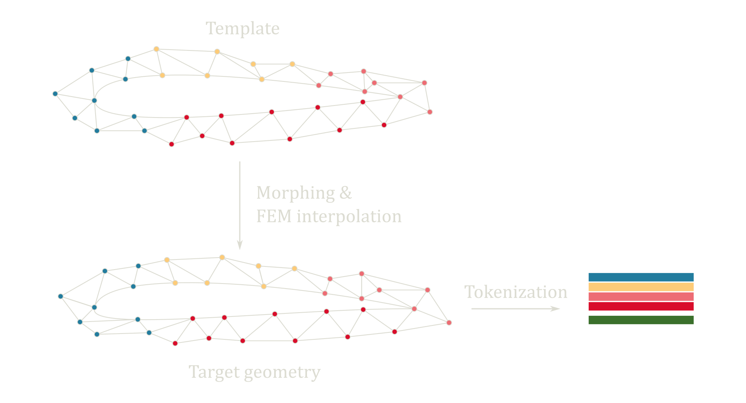
Experiments
Cross-sample partitioning consistency?
MMVT (Mesh Morphing Vision Transformer)

Slide 24
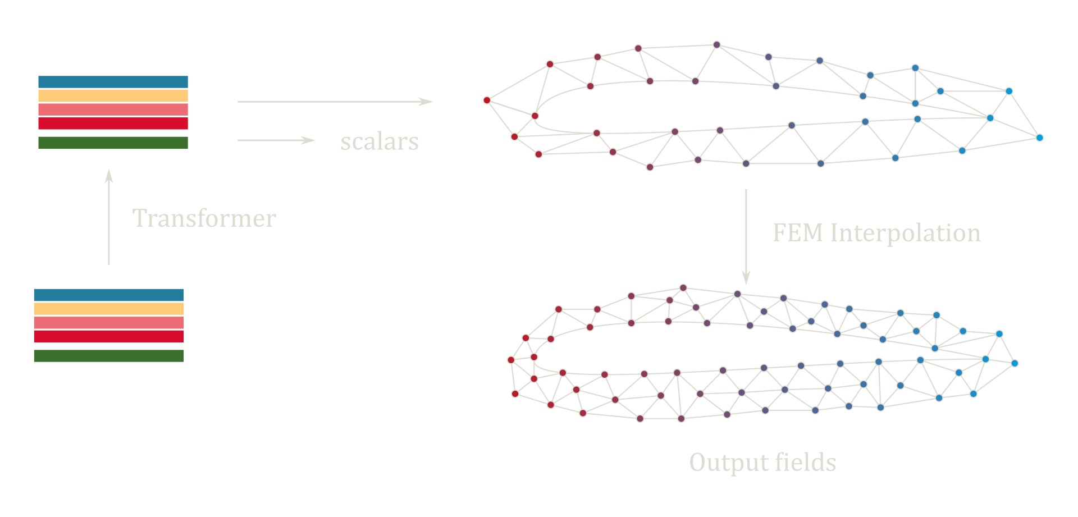
Experiments
Cross-sample partitioning consistency?
MMVT (Mesh Morphing Vision Transformer)

Slide 25
Experiments
Cross-sample partitioning consistency?
MMVT (Mesh Morphing Vision Transformer)

Slide 26
Experiments
Questions
Patch regularity
Order of nodes within each patch? 🧐
Cross-sample partitioning consisitency (relative position of patches)? 🤔
Shape of patches? 🤔
Positional encoding? ❌

Slide 27
Results

Slide 28
POWERED BY TRANSFORMERS

